Slide 1



LESSON 3
Debate: Should the government
ban the sale of disposable vapes?
The Science of Nicotine

Slide 2
Ground rules…
It’s great to be open and honest but we should avoid discussing our own, or other people’s personal or private lives.
It’s fine for us to disagree with another person’s opinion but being respectful means that we will not judge or put down the person.
It’s great to take part in PSHE lessons but we have the right to pass on answering a question or participating in an activity if we don’t feel comfortable.
It’s great to ask questions. However, we do not ask personal questions, or anything intended to deliberately try to embarrass someone.
We know that we can find further help and advice, both in school and in our community. We will encourage friends to seek help if we think they need it.
Notes:
3 minutes: Revisit ground rules for PSHE lessons.
*Remind the children that you as a teacher cannot promise confidentiality. If you are concerned that a pupil is at risk, you would follow the school’s safeguarding policy.

Slide 3
QUIZ
5 questions to get you warmed up!
Notes:
10 minutes

Slide 4
Question 1
Since the 1970s plastic production has increased much faster than any other material. What is the most discarded waste item worldwide and also the most common plastic litter on beaches?
Plastic bottles
Cigarette butts
Chewing gum

Slide 5
Question 2
Lithium is a metal that is used predominantly in:
Batteries
Fertilizer
Pipes

Slide 6
Question 3
The brain does not stop developing until:
Mid-teens
Mid-to-late 20s
Early 40s

Slide 7
Question 4
What's the maximum capacity of e-liquid that a vape tank can legally contain?
5ml
3ml
2ml

Slide 8
Question 5
The UK Government want England to be ‘smoke-free’ by when?
2025
2030
2035

Slide 9
ANSWERS
Let’s see how you do…
The answers to these questions may help
you with your debate…

Slide 10
Question 1
Since the 1970s plastic production has increased much faster than any other material. What is the most discarded waste item worldwide and also the most common plastic litter on beaches?
Plastic bottles
Cigarette butts
Chewing gum
Answer: Cigarette butts
Cigarette butts contain filters made of cellulose acetate, a man-made plastic material. These can take up to 10 years to completely degrade.

Slide 11
Question 2
Lithium is a metal that is used predominantly in:
Batteries
Fertilizer
Pipes
Answer: Batteries
Demand for lithium is soaring as the metal is used to store energy. In order to reach net-zero and meet the climate goals, lithium batteries are needed to help store renewable (clean) energy.

Slide 12
Question 3
The brain does not stop developing until:
Mid-teens
Mid-to-late 20s
Early 40s
Answer: Mid-to-late 20s
The part of the brain behind the forehead, called the prefrontal cortex, is one of the last parts to mature. This area is responsible for skills like planning, prioritizing, and making good decisions.

Slide 13
Question 4
What's the maximum capacity of e-liquid that a vape tank can legally contain?
5ml
3ml
2ml
Answer: 2ml
The maximum capacity for a vape tank is 2ml (that's 2ml of liquid though, not nicotine). The maximum amount of nicotine allowed in the liquid is 2mg of nicotine per 1ml of fluid. Otherwise expressed as 2mg/ml (or 2%).

Slide 14
Question 5
The UK Government want England to be ‘smoke-free’ by when?
2025
2030
2035
Answer: 2030
‘Smokefree’ will be achieved when adult smoking prevalence falls to 5% or less.
However, The Kahn Report in 2022 found that “without further action, England will miss the smokefree 2030 target by at least 7 years, and the poorest areas in society will not meet it until 2044”

Slide 15
Debate: Should the government
ban the sale of disposable vapes?
Disposable vapes
Disposable vapes come ready to use, prefilled with e-liquid and can be used straight away. Once the e-liquid or the battery runs out they cannot be recharged or refilled so they are then thrown away
Regulation
To restrict or control the use of something according to a set of established criteria. For instance, the sale of alcohol is regulated. It cannot be sold in shops to under 18s.
Keywords in this debate:
To ban (something)
To prohibit or not allow (something to happen). For instance, the sale of Ketamine is banned.

Slide 16
Why are we debating this?
What we already know…
There are lots of views on different elements of vaping such as the concerns around the health impact of inhaling nicotine.
In this lesson we want to focus on one of the questions that concern people when it comes to vaping, specifically the issue of disposable vapes.
There are lots of types of vapes. For instance, refillable vapes. Disposable vapes come ready to use, prefilled with e-liquid and can be used straight away. Once the e-liquid or the battery runs out they cannot be recharged or refilled so they are then thrown away.
Notes:
3 minutes: Why are we debating this? (slide 16 and 17)

Slide 17
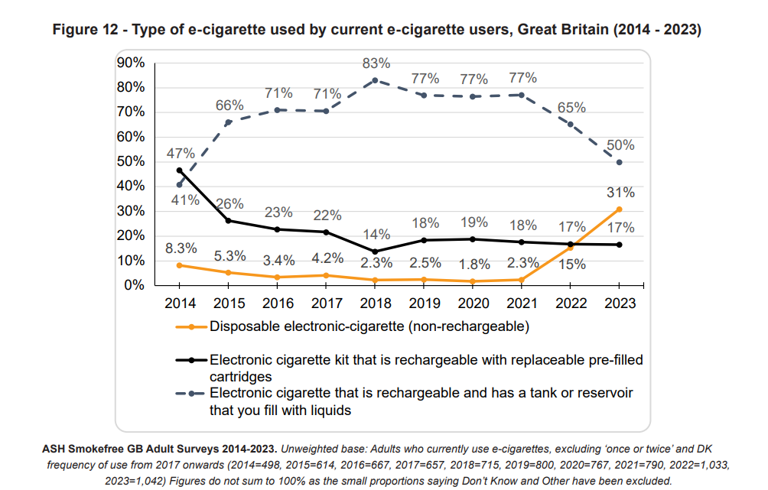
Why are we debating this?
Important context…
Younger adults are mostly driving the increase in using disposable e-cigarettes as the main type of e-cigarette.
For 18-24 year olds, more than half of current e-cigarettes users (57%) use disposables as their main type in 2023, an increase from only 2.8% in 2021.
In 2023, disposable e-cigarettes are also the most popular main device type among 11-17 year old e-cigarette users (69%).
Notes:
Remind students that ‘vapes’ are also known as e-cigarettes. Different types include vape pens, vape bars, pod devices, ‘mods’, and ‘cigalikes’; some are rechargeable and refillable, while others are disposable. They work by heating a liquid that can then be inhaled. The liquid typically contains nicotine, propylene glycol, vegetable glycerine, and flavourings, but not tobacco. They therefore do not produce tar or carbon monoxide (two of the most damaging elements in tobacco smoke).

Slide 18

Should disposable vapes be banned?
Watch the video:
Notes:
7 minutes – watch the video

Slide 19
Preparing for the debate
Should the government ban the sale of disposable vapes?
You will be given a card with an argument on…
Find another person to talk to…
if your arguments are for the same side of the debate, whose argument is strongest? Why?
if your arguments are for opposite sides of the debate, whose argument should win? Why?
TIP: Aim to talk to each person for about one minute before finding someone else.
Swap cards with that person and repeat the process.
Notes:
8 minutes: Preparing for the debate

Slide 20
Find everyone on your side of the debate
Team A must argue
that the answer is YES.
Team B must argue
that the answer is NO.
A
B
Get into groups!
Notes:
5 minutes: Categorise your cards!
Everyone needs to take their card and find their group (A or B)…

Slide 21
Each group must then categorise the cards
they have into Health, Environmental & Other…
1.3 million single use vapes are thrown away every week, per annum this is enough to cover 22 football pitches. The number of vapes thrown away are contributing to the fastest growing waste stream in the UK.
Health
Other
Environmental
Notes:
…then categorise their cards into environmental, health or other issues (there is overlap for some cards).
(see example ‘1.3 million single use vapes are thrown away…’ goes into the environmental category)

Slide 22
Team A must argue
that the answer is YES.
Team B must argue
that the answer is NO.
A
B
Get ready for a debate!
There will be two ‘listeners’ in each group who will observe the debate and feedback to the teacher on the strength of the arguments
Notes:
Depending on the size of the class, you could either split them into group A and B, or you could do two/three groups of A and two/three groups of B.
Any children who might struggle with this activity can be ‘listeners’ and help you as the teacher decide which team wins the debate!

Slide 23
How to debate… informally*
In a formal debate there would be a very specific order.
In this debate one confident person needs to start the debate for team A – you will be the opening speaker. Then the opening speaker for team B will speak. After that, the debate can be free flowing.
Be polite, listen and don’t interrupt another person’s point.
Prepare your arguments as a group (you have already categorised them) and think about how to use the information on the cards as evidence to support each other’s point.
Try to think about what points the other team might make. How could you argue against them?
Before you deliver your point in the debate, can you refute (go against) the opposing point from the other team?
Deliver your point confidently! Make eye contact with the other team, gesticulate and use persuasive language (‘it is clear to see…’ or ‘I am confident that, based on the evidence…’
*this will not take the form of a parliamentary debate
Notes:
*this is not a parliamentary debate but if the class is familiar with this style, then go ahead and use this format.
18 minutes: The Debate!

Slide 24
Language to use in a debate
If you agree, you could say…
“Yes, and…”
“I think that’s right because…”
“Another reason for that is…”
“I think _________ would agree with you because…”
“An example to support this point is…”
If you don’t agree, you could say…
“Yes, but…”
“I’m not sure about that because…”
“But what if…”
“I think ____________ would think differently because…”
“I see what you’re saying, however…”
Notes:
Print out this slide for pupils who may struggle to articulate their point

Slide 25
Be sure to have a look at the information sheets stuck around
the room. Some cards ask you to
look at a specific image.

Slide 26
VOTE
Yes
Should the government ban the sale of disposable vapes?
No
Notes:
Ask some pupils to justify their answer…

Slide 27
Has anyone changed their answer? If so, why?
Yes
No
Notes:
Plenary vote: 3 minutes

Slide 28

Disposable vapes: other options
Watch the video:
Notes:
3 minutes – watch the video

Slide 29
Plenary/Extension/follow up tutor time activity
ASH (Action for smoking and Health) suggest that we should not ban disposable vapes, but we should also not do nothing… they make the following suggestions.
They are:
Put a specific tax on disposable vapes of £5
Prohibit branding that would appeal to children
Reinstate funding for sustained anti-smoking campaigns promoting vaping as the most effective quitting aid available for adult smoker
Prohibit in-store promotion of e-cigarettes with exemptions for age-restricted, specialist vape shops.
What are the intended effects and the potential downsides to each of these suggestions?
How do you make vaping appealing to current smokers but not to ‘never smokers’?
Pick one of these suggestions and argue in favour of it.
Notes:
10-15 minutes

Slide 30




Find out more
If you would like to learn more about nicotine or you are concerned about yourself or another person’s nicotine use:
ash.org.uk
drugscience.org.uk
Click on the image above to find your nearest stop smoking services
Scan here for the NHS quit smoking page where you find advice and download the quit smoking app

