Slide 2
Lesson 2
Harm reduction
jointheexchange.co.uk
drugscience.org.uk

Slide 3
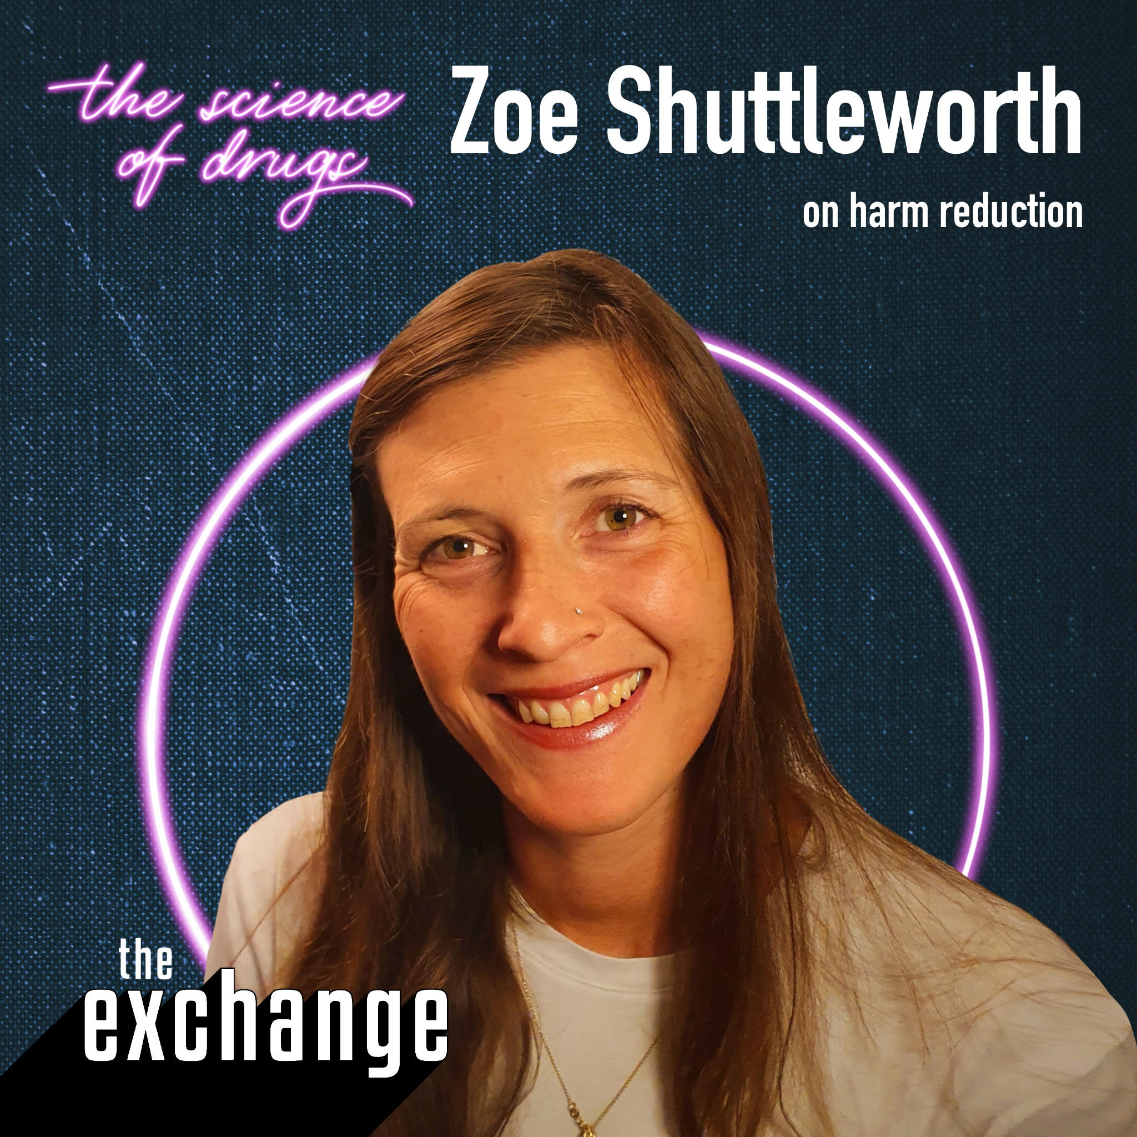
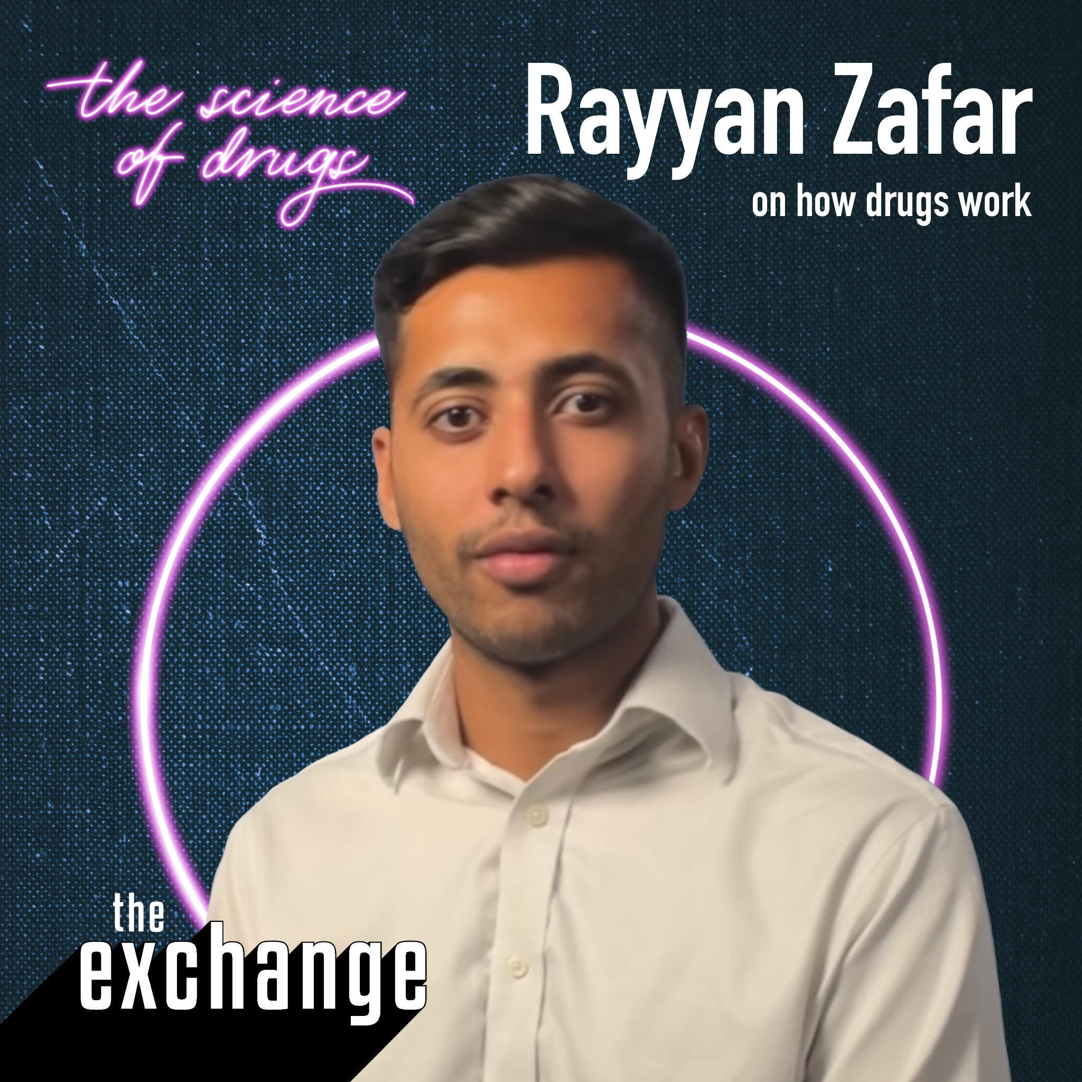
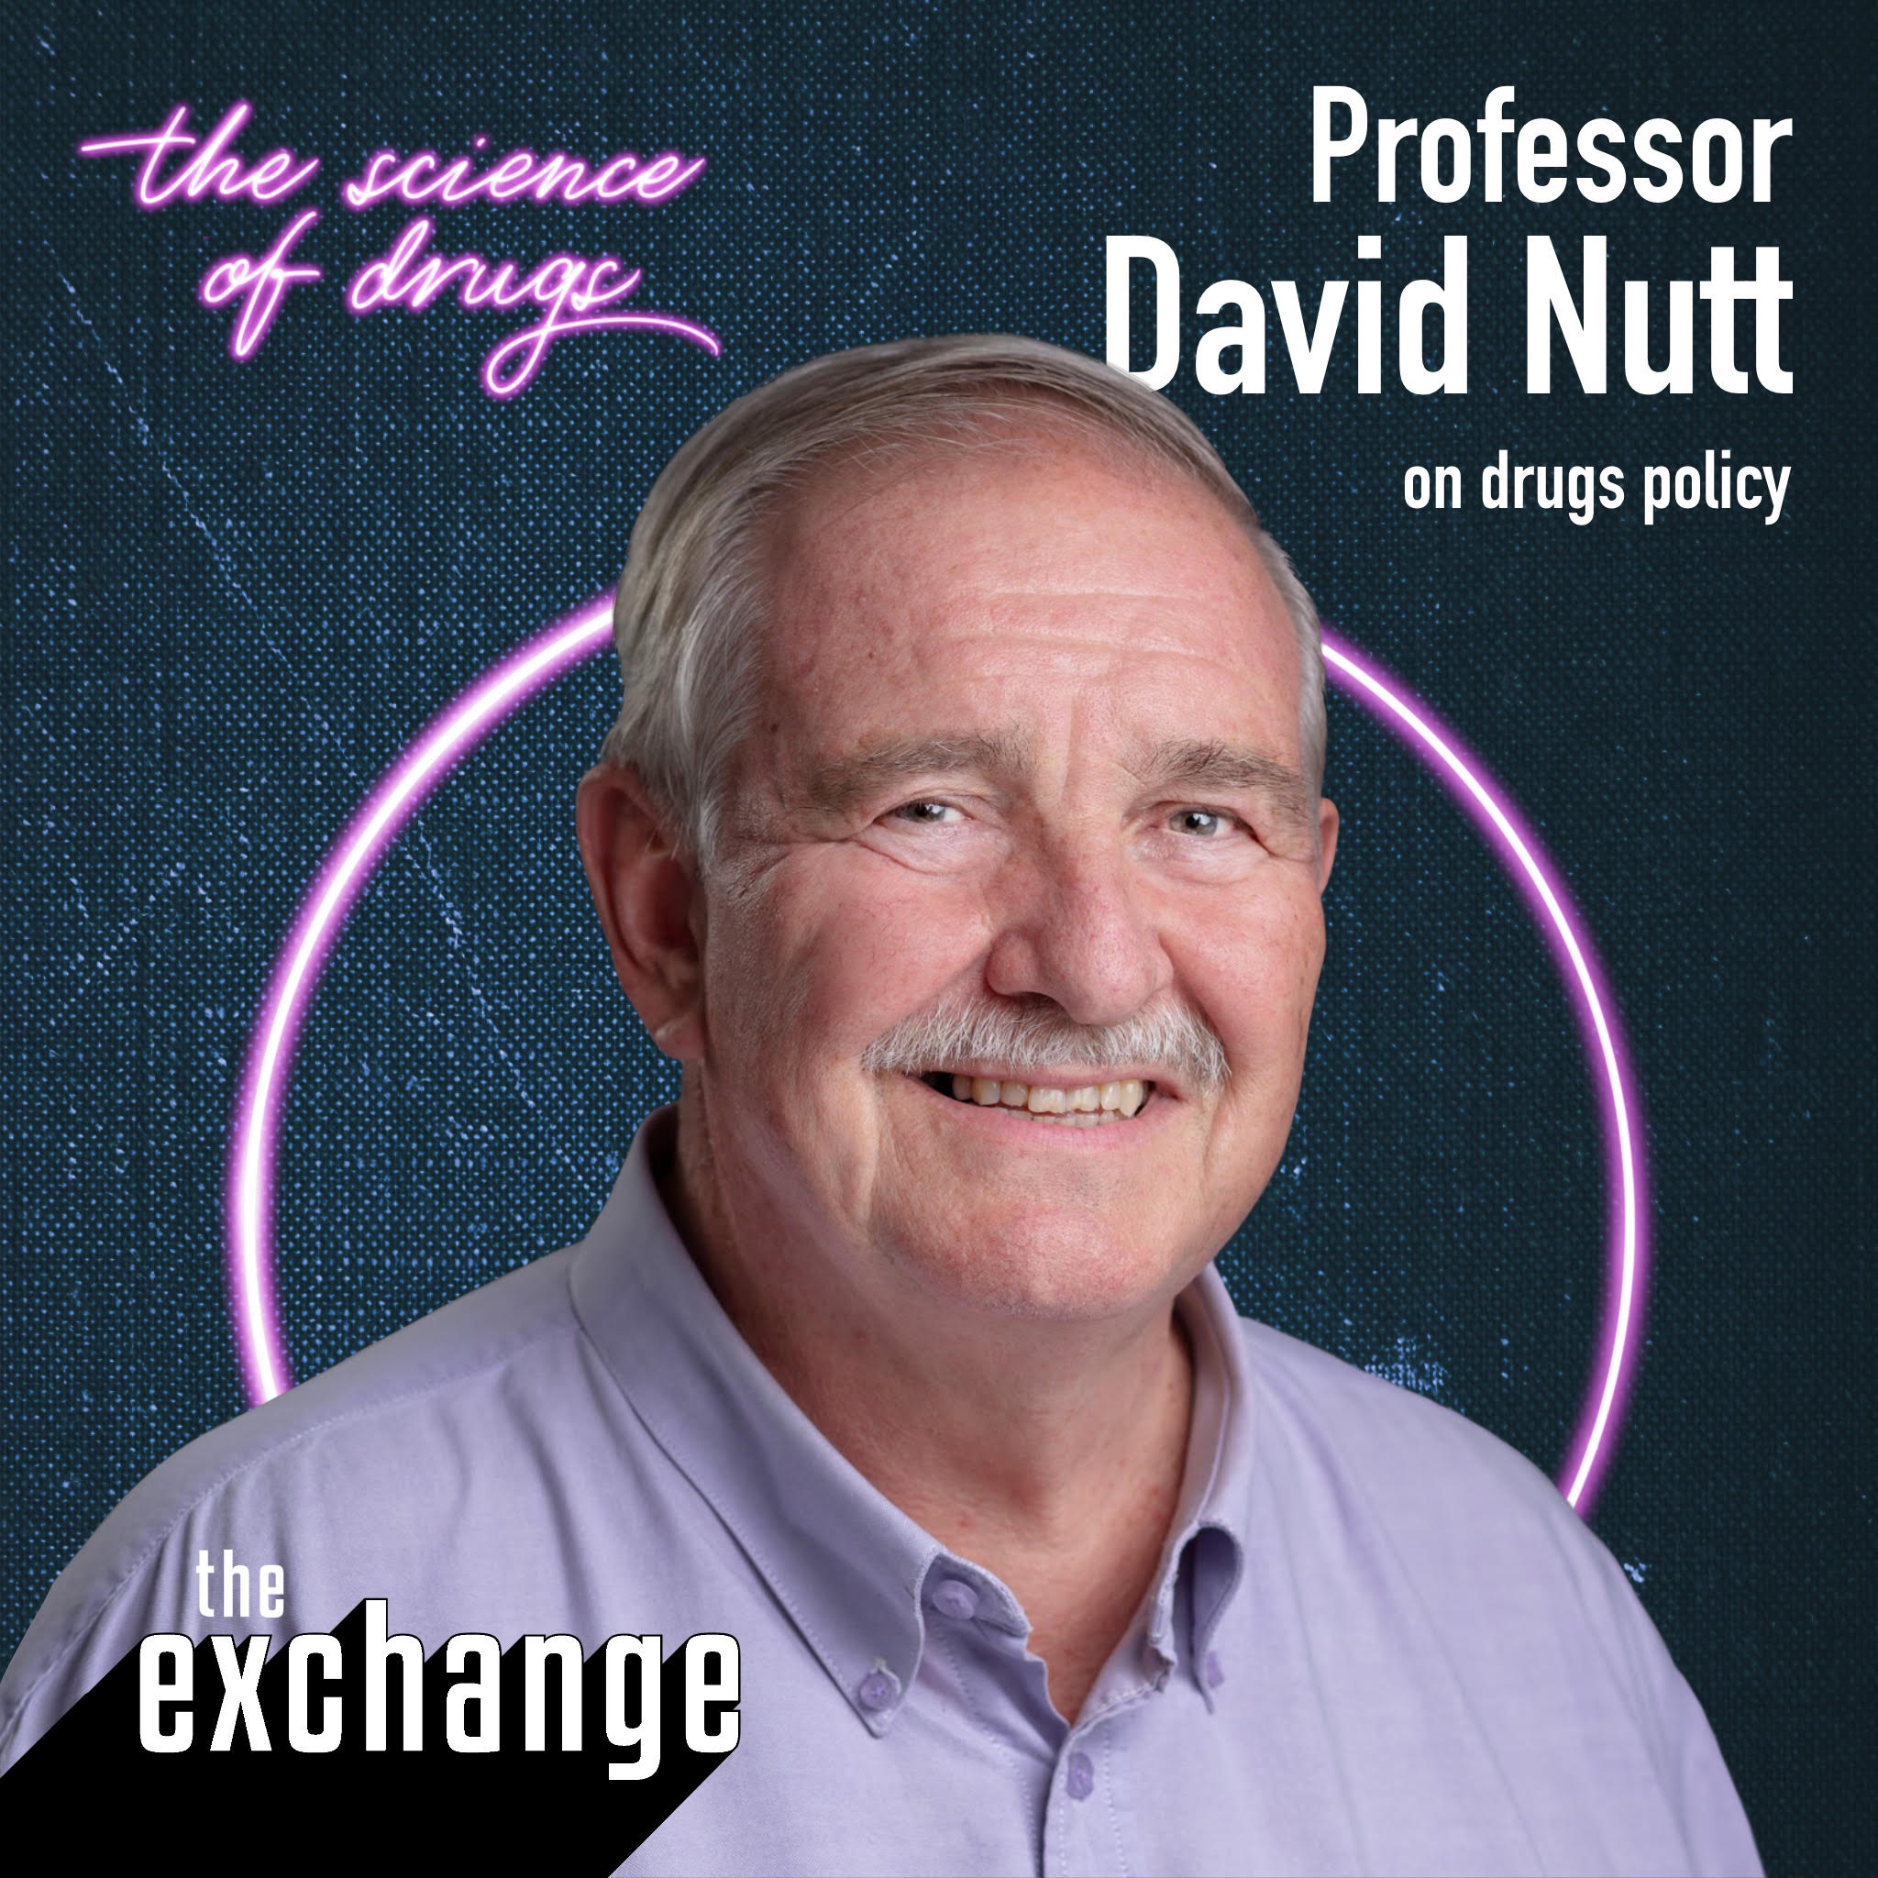
In this lesson we’ll be hearing from…
Zoe Shuttleworth Director at It Happens Education (RSHE provider)
Rayyan Zafar PHD Student at the Centre for Psychedelic research and Neuropsychopharmacology
Professor David Nutt FRCP, FRCPsych, FMedSci. A psychiatrist at Imperial College London and Founder of Drug Science

Slide 4
What’s the law?
Which drugs are in which Class?
The three classes of illegal drugs Illegal drugs are put into three categories based on the level of risk: Class A (most risky), Class B and Class C.
Class A | Possession: Up to 7 years in prison, an unlimited fine or both | Supply and production: Up to life in prison, an unlimited fine or both
Class B | Possession: Up to 5 years in prison, an unlimited fine or both | Supply and production: Up to 14 years in prison, an unlimited fine or both
Class C | Possession: Up to 2 years in prison, an unlimited fine or both (except anabolic steroids if it’s for personal use) | Supply and production: Up to 14 years in prison, an unlimited fine or both
Cocaine
Anabolic steroids
Ecstasy (MDMA)
Cannabis
Heroin
Xanax
LSD
Ketamine
Magic Mushrooms
Codeine
Cocaine, Ecstasy (MDMA), Heroin, LSD, Magic Mushrooms
Cannabis, Ketamine, Codeine
Anabolic Steroids, Xanax

Slide 5
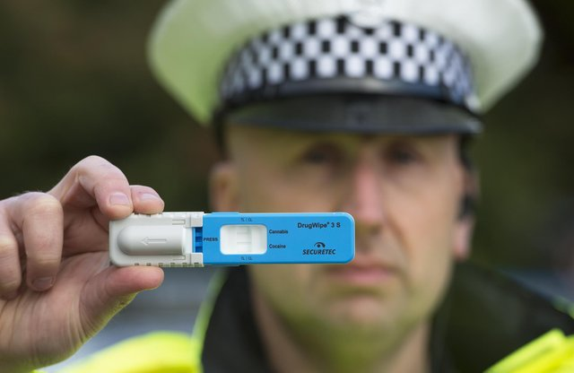
You can get a warning, caution, fine or prison sentence for:
Other criminal offences include:
Driving under the influence of alcohol or drugs
Drunk and disorderly behaviour (ASBO)
Possession
Having drugs, carrying drugs
Production
Making drugs
Cannabis and Cocaine drugs test
Supply
Selling, dealing or sharing drugs
* ‘Supply' can be giving your friend a drug. No financial exchange is required!
A drug offence on a criminal record can prevent you from becoming a doctor, teacher, lawyer and many other professions! You also will never be able to travel to America!
The penalties depend on the type of drug, the amount you have, and whether you’re also dealing or producing it.

Slide 6
Furthermore, the Psychoactive Substances Act 2016 makes it an offence to produce or supply any substance that has a psychoactive other than nicotine, alcohol, caffeine and medicines. This includes drugs like Nitrous Oxide and Poppers…
Offence | Summary (Magistrates Court) | Indictment (Crown Court)
Possession | Not an offence | Not an offence
Possession in a custodial institution | Up to 12 months and/or a fine* | Up to 2 years and/or a fine
Possession with intent to supply | Up to 12 months and/or a fine* | Up to 7 years and/or a fine
Supply/offer to supply etc. Supply can be giving your friend one of these drugs. No financial exchange is required! | Up to 12 months and/or a fine* | Up to 7 years and/or a fine
Production | Up to 12 months and/or a fine* | Up to 7 years and/or a fine
Importation/Exportation | Up to 12 months and/or a fine* | Up to 7 years and/or a fine
Failure to comply with a Prohibition or Premises notice | Up to 12 months and/or a fine* | Up to 2 years and/or a fine
*Summary convictions in Northern Ireland are up to 6 months and/or a fine. Offences under the PSA would be considered ‘aggravated’ if they involved supply to under 18s, were near a school or a children’s home (Local authority children’s homes etc).

Slide 7
Unfortunately the way drugs are classed by UK law does not necessarily give you all the information you need to know (see later lesson with Professor David Nutt, Founder of Drug Science)

Slide 8
Why is it important to talk about…
…not just the law?

Slide 9
Watch the clip for Zoe’s thoughts on this question…

Slide 10
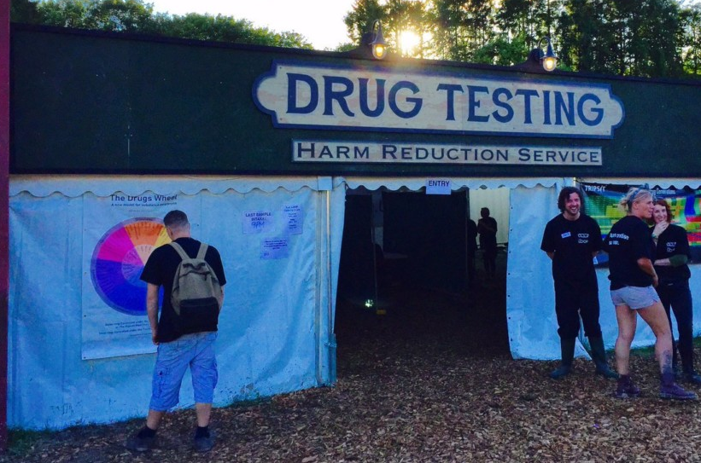
What is harm reduction in the context of drugs education?
Any recreational drug use is likely to carry a degree of risk. This includes legal highs such as alcohol and tobacco but is especially true of illegal drugs due to lack of regulation and the often unsafe context in which they may be consumed.
Harm reduction refers to policies and practices that try to reduce the harm that people do to themselves or others from their drug use.

Slide 11
Scenario…
Ben is struggling with the pressure of his GCSEs. He has never taken drugs before but he is desperate to relax and is looking for a way to switch off. He sneaks out to the park on Friday evening (telling his mum that he was going to the cinema) and meets up with some friends who are drinking beers. They are approached by a drug dealer who offers them ‘K’ (Ketamine).
His friends buy a gram for £21 and offer Ben some saying it will help him relax. Ben is reluctant but his friends tease him for being pathetic. Ben gives in and snorts some.
Think back to last lesson. Based on what you know about the drug, the set and the setting, what are the possible dangers in this situation?
If we were to replay this scenario, what advice would you give Ben in order to reduce the possibility of harm?
Profile
16 year old boy
Slim build
Taking prescribed Prozac (an antidepressant) on prescription from his doctor
Notes:
Get pupils to work in pairs to think of ways they could reduce the harm of the drug

Slide 12
Due to the illicit nature of drug use there is no quality control over street drugs.
How do you know what you are taking?
The biggest risk when it comes to taking illegal drugs is the fact that these drugs are made by people involved in the illegal drugs trade with the motive of profit, not with the motive of your safety!
Without getting them professionally checked, there is no way you can possibly know exactly what chemicals, or how much of them, is in a drug from an illegal source.
*Drug dealers are not medically or pharmaceutically trained to synthesise drugs. Even if you know your drug dealer, they might not even know what they're giving you.

Slide 13
Drug testing…
The Loop are an organisation that test drug samples at a number of festivals and clubs. If they find a significant number of pills or powders that have been cut with dangerous substances, or if there is a particularly ‘pure’ drug at a festival, they put out warnings on social media like this.
Have a read What is the issue with MDMA now?

Slide 14
Have a listen to Professor David Nutt talk about the work of The Loop.
Discussion
What do you think about taking illegal drugs to a tent at a festival to get them tested?
Why do you think the government are encouraging this approach?
Do you think it’s right?
Notes:
You could even have a debate around whether harm reduction at festivals is right
The motion could be ‘This house believes that harm reduction is a breach of the law’

Slide 15
Stay safe…
DO YOU KNOW THE RECOVERY POSITION?
If the patient is unresponsive (check by gently pinching them and calling their name) but breathing with a pulse, you should put them in the recovery position. It stops them choking on their own tongue and their vomit.
Call 999 YOU COULD SAVE SOMEBODY’S LIFE!
IS YOUR PHONE CHARGED? ARE YOU SAFE? ARE YOU WITH PEOPLE YOU CAN TRUST?
Notes:
Depending on the size of the class, you could a) just watch the video b) get two people at the front to demonstrate c) put everyone in pairs to have a go and to take it in turns.

Slide 16
Stay safe…
THE BEST WAY TO STAY SAFE IS TO NOT TAKE DRUGS AT ALL!
Don’t be afraid to call 999 and ask for an ambulance if you are worried about your friend
Make sure you know where you can get help if things go wrong
It’s important that a person researches what they are taking (The Drug Science website is great and The Loop will test a person’s drugs at festivals)
Remember that ‘pure’ doesn’t necessarily mean safe
If a person chooses to take drugs, it’s better that they take a quarter of what they are given and don’t re-dose for at least an hour
Don’t mix drugs
Anyone taking drugs should ensure they are with a safe person and in a safe place

Slide 17
Watch the video for Zoe’s top tips on harm reduction.

Slide 18
Extension Task
*If the topic of regulation vs criminalisation of drugs arises in the lesson, please use this 5 minute clip with David Nutt as a way of starting a discussion.

Slide 19
dsmfoundation.org.uk
drugscience.org.uk
talkaboutalcohol.com
themix.org.uk
ithappens.education
nhsgo.uk
riseabove.org.uk
youngminds.org.uk
Notes:
Modify to include school support.
Leave up on the screen and then send around to your class after the lesson so that they know where to go if they need further help and support.

