Slide 2
A short message from Hannah Dawes
Teacher Only
PSHE educator and founder of the Exchange
“Science has to underpin conversations around drugs because clear, evidence-based information enables people to make informed choices.
The traditional ‘just say no’ to drugs message hasn’t worked particularly well and I am keen to see teenagers across the UK equipped with the facts so that they can make safe decisions. In these lessons we are focusing on the science and not the social impact of drug use (e.g. the impact of addiction on society or how alcoholism affects family life). Of course, it’s difficult to separate the two, but I believe the first step is to know the facts, and that is the aim of my series on the science of drugs. I hope you find it useful!”

Slide 3
Our collaboration with Drug Science
Teacher Only
It’s exciting to collaborate with Drug Science on these resources. Drug Science is the leading independent scientific body on drugs in the UK. They work to provide clear, evidence-based information without political or commercial interference.
“For far too long school students have been denied access to the truth about drugs, which has undermined their trust in health information in general and put them at greater risks of harm. This new Exchange/Drug Science initiative sets out to rectify this failure by presenting teaching materials that are evidence-based, balanced and proportionate. In this way we hope to minimise the harms from the use of all drugs, whether legal or illegal”
_____
Prof David Nutt

Slide 4
An introduction for teachers
Teacher Only
by Zoe Shuttleworth from It Happens Education
“Obviously we all know the safest way to use drugs is to not use them at all… and despite the ‘just say no’ message, we know that a significant number of people are using substances” _____
Zoe Shuttleworth

Slide 5
Lesson 1
How drugs work
jointheexchange.co.uk
drugscience.org.uk
Notes:
START LESSON HERE…

Slide 6
In this lesson we’ll be hearing from…
Zoe Shuttleworth Director at It Happens Education (RSHE provider)
Rayyan Zafar PHD Student at the Centre for Psychedelic research and Neuropsychopharmacology

Slide 7
STARTER:
Which is the most commonly used drug in the UK?
Notes:
Answer: Alcohol is the most commonly used drug - 85% of the adult population take the drug – tobacco is used by around 20% of the adult population and cannabis is the most popular ILLEGAL drug with around 3-4 million people using the drug last year in the UK.

Slide 8
What are psychoactive drugs?
Notes:
In pairs see if pupils can come up with a definition for ‘drugs’

Slide 9
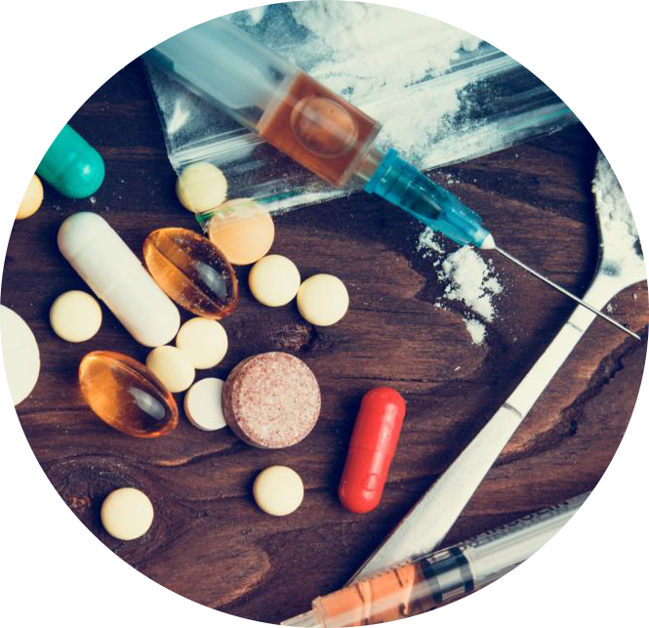
Substances that alter, block, or mimic chemical reactions in the brain.
This can affect a person’s physiology (the way their body behaves) and/or their psychology (the way they think).

Slide 10
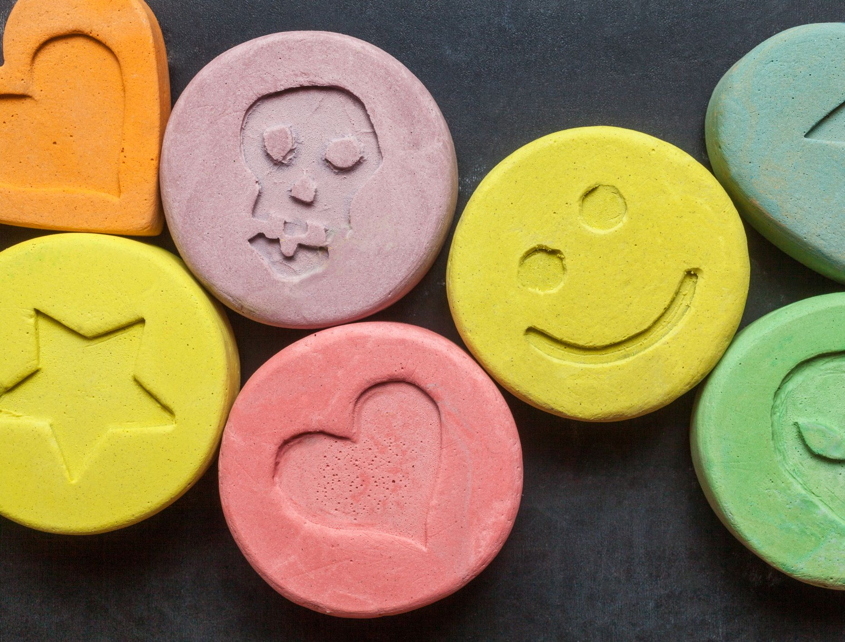
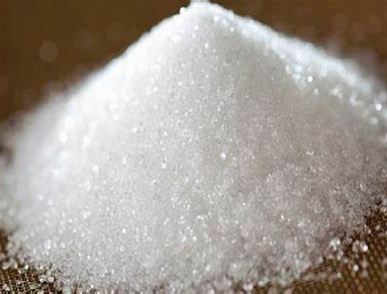
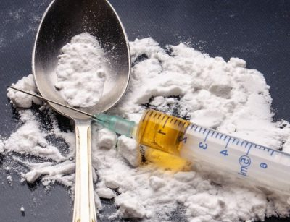
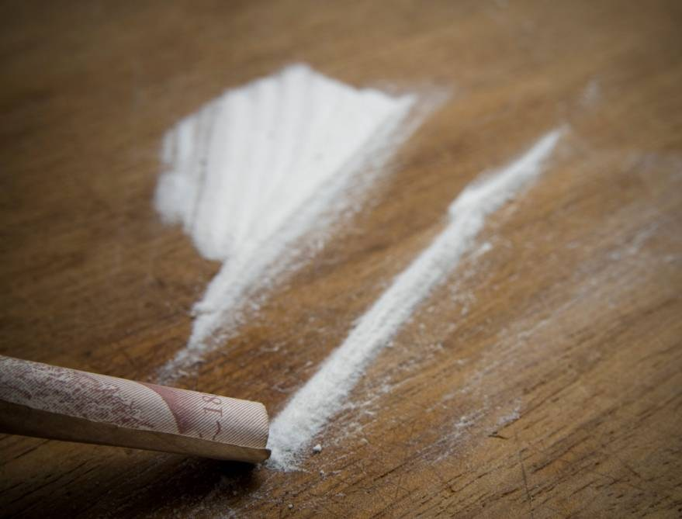
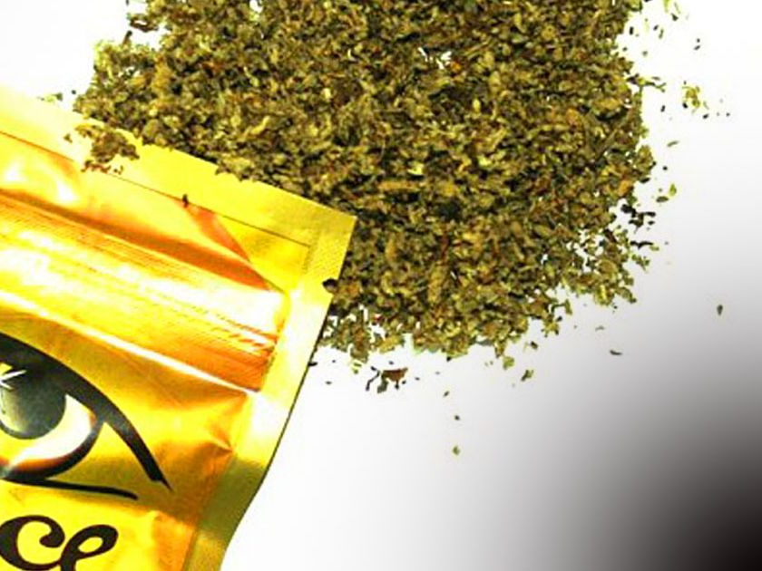
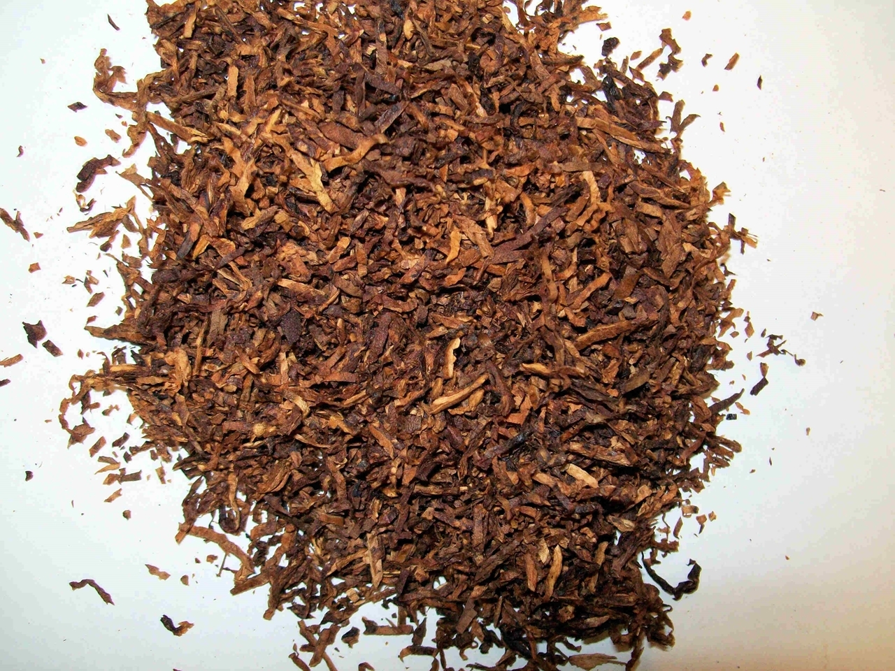
What do you know?
How many of these drugs can you name?
A
B
C
D
E
F
G
H
I
Notes:
Give pupils 3 minutes to see what they can do!

Slide 11
What do you know?
How many of these drugs can you name?
A. MDMA
B. Sugar
C. Heroin
D. Cocaine
E. Spice (synthetic cannabis)
E
F. Paracetamol
G. Nos (Nitrous Oxide)
H. LSD
I. Tobacco
Which of these drugs are legal?
Notes:
Which are legal?
Sugar
Paracetamol
Tobacco
Note Nos is illegal if it is intended to be used for human consumption. However it is widely used as a preservative and propellant in whipped cream dispensers. Reusable whipped cream dispensers are recharged with small metal containers filled with nitrous oxide.

Slide 12
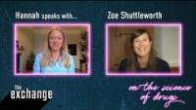
So why do you think that people choose to use drugs?
How many can you come up with?

Slide 13
Answer these questions using the Club Drugs Wheel…
1 | What sorts of feelings are associated with stimulants?
2 | Give one example of an opioid.
3 | Which category of drug does Ketamine fall under?
4 | Which category of drug is associated with overheating and dehydration?
5 | Which category of drug does MDMA fall under?
Check your answers with the sheet!

Slide 14
Let’s watch Rayyan Zafar speak about the adverse effects of MDMA.
As you watch, jot down anything new you learn.

Slide 15
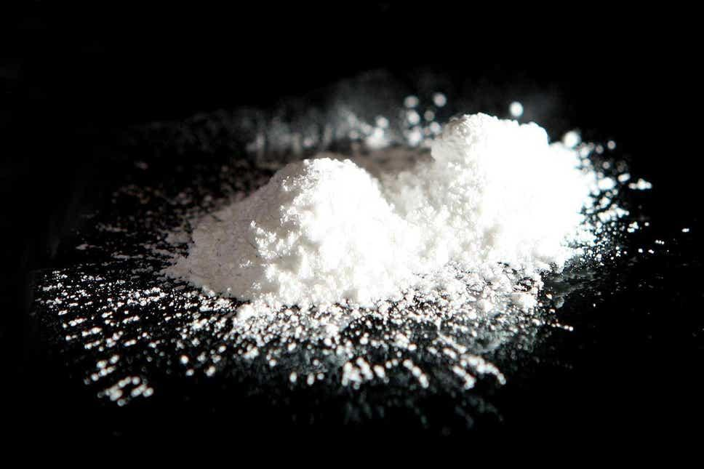
Rayyan mentions MDMA in the interview…
In your groups you are going to research MDMA, ketamine and cannabis (as it’s the most widely used illegal substance in the UK) further using the information sheets and then two groups will be picked at random to present their findings.
FACT: It used to be thought that cannabis wasn’t addictive. Now it is clear that this is not true at all, about 9% of people that have used cannabis will become addicted. (Source: Drug Science website)

Slide 16
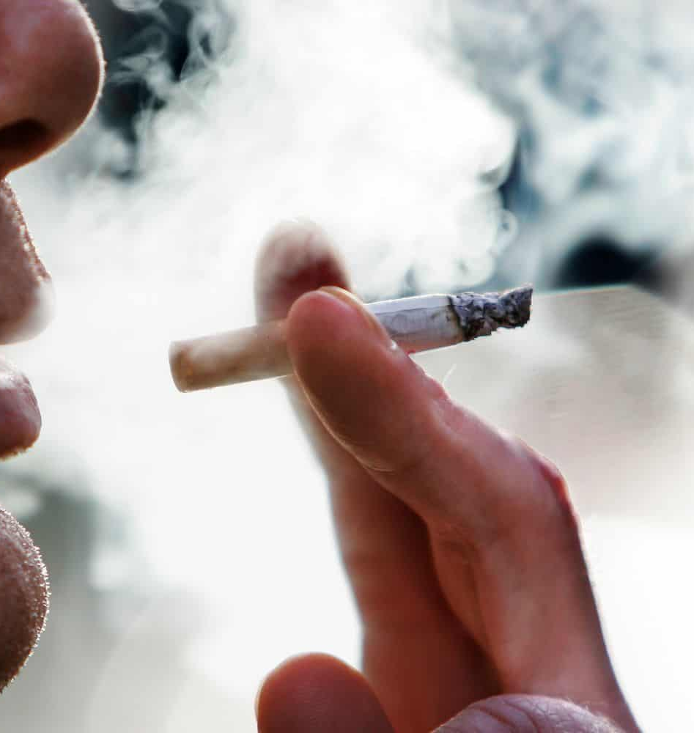
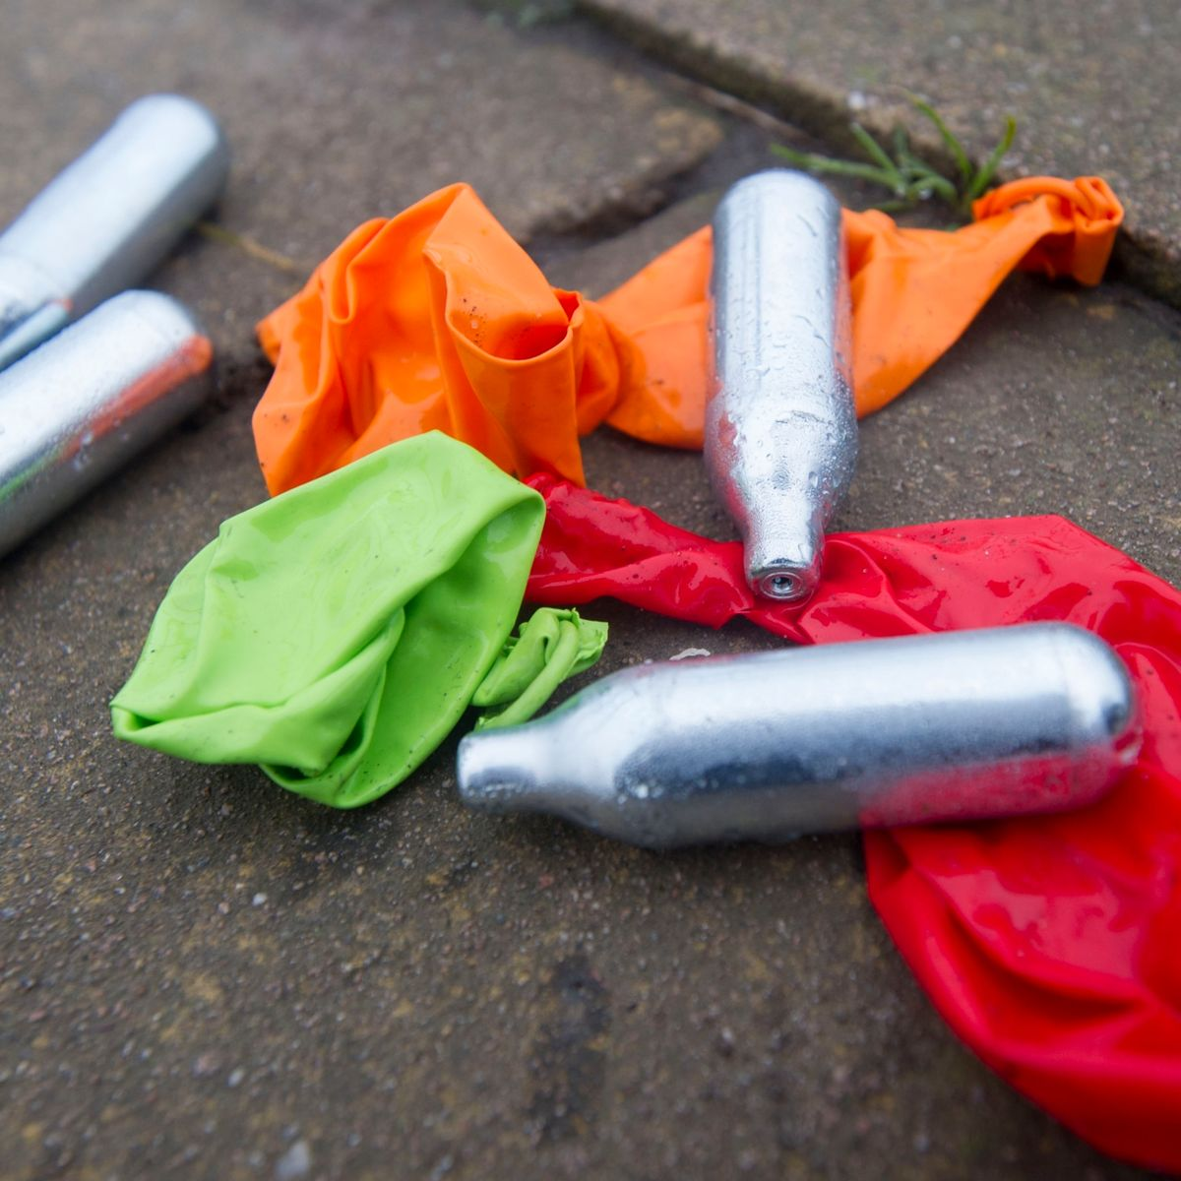
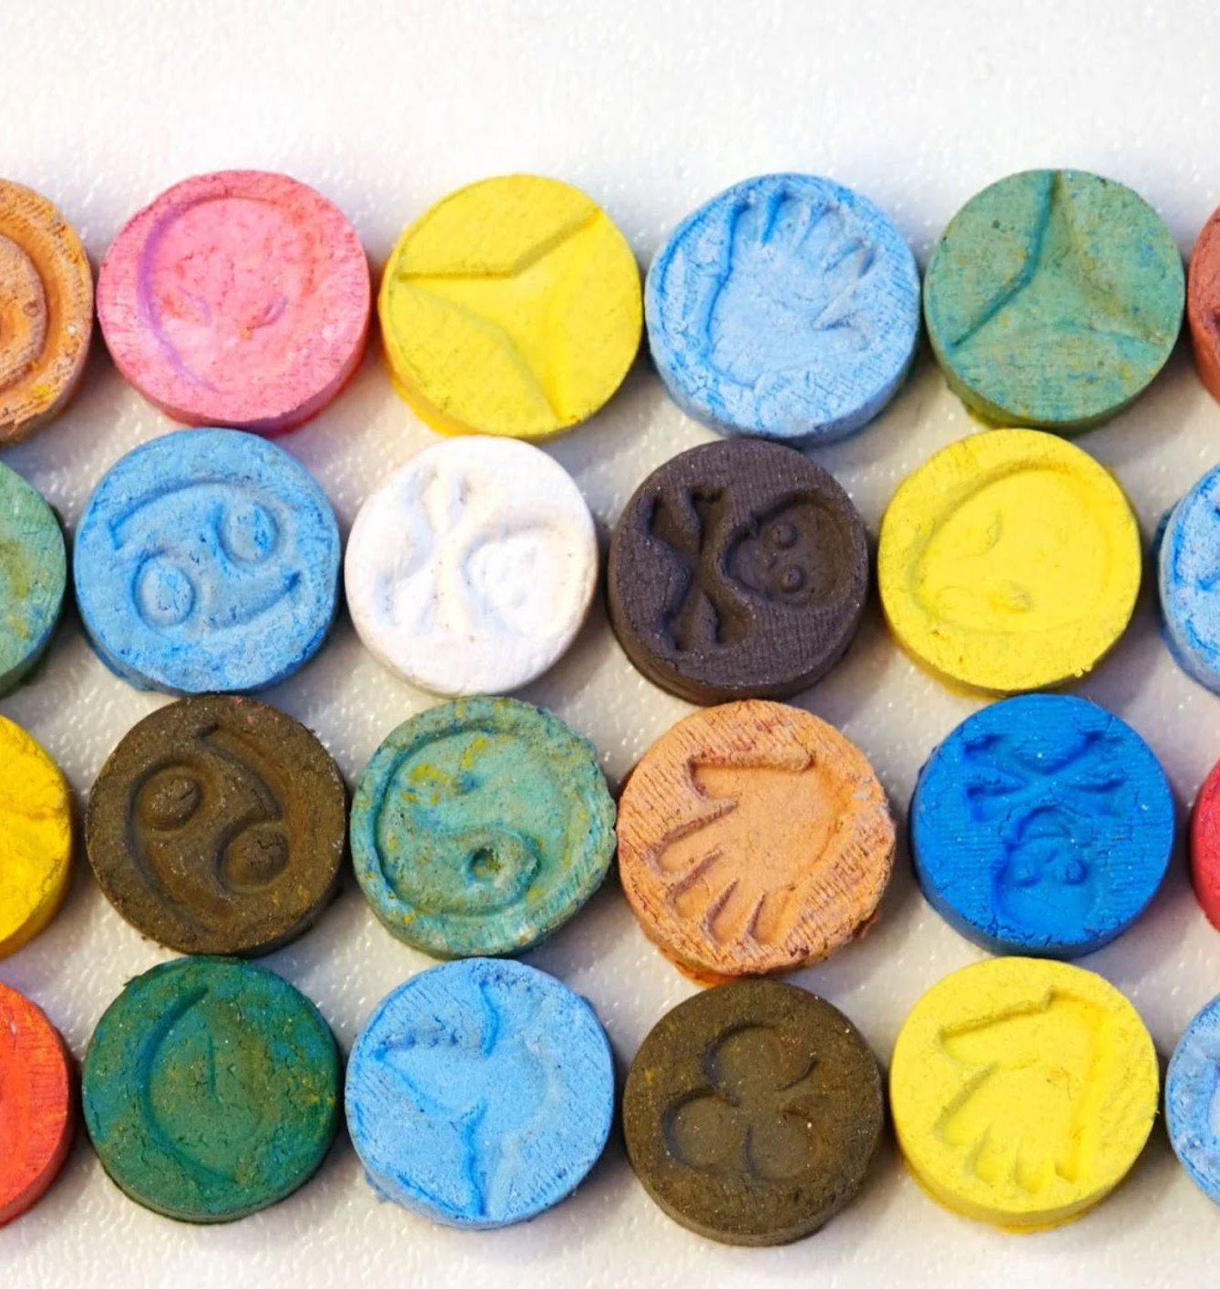
What makes taking drugs risky?
In pairs or groups, write down all the risks associated with taking drugs (medicines, legal and illegal drugs)

Slide 17
Rayyan and Zoe speak about the risks in three areas:
1. The drug | 2. The set (the person) | 3. The setting (the place)
What is it, how strong it is, what else is mixed with it (what it has been cut with), what effect it could have on you, and whether other substances or medication have been taken. | Their genes, their build, their mood at the time, their health (physical and mental), their sex, expectations, tolerance, what activity they are doing e.g. dancing. | Is it crowded or deserted? Hot or cold? Are their friends looking out for them? Are there risks like busy roads, open water, open windows?
Can you fit each of your answers into one of these categories?

Slide 18
Next lesson we will be discussing harm reduction
Before you go… what facts can you remember from today’s lesson?
Notes:
Recall exercise: teacher to ask for a show of hands or pick pupils randomly… or go around the classroom asking for a fact.

Slide 19
dsmfoundation.org.uk
drugscience.org.uk
talkaboutalcohol.com
themix.org.uk
ithappens.education
nhsgo.uk
riseabove.org.uk
youngminds.org.uk
Notes:
Modify to include school support.
Leave up on the screen and then send around to your class after the lesson so that they know where to go if they need further help and support.

