Slide 1
The History of Tobacco
LESSON 1

Slide 2
Teacher Slide
Please watch this video before teaching the series of lessons:

Slide 3
Ground rules…
It’s great to be open and honest but we should avoid discussing our own, or other people’s personal or private lives.
It’s fine for us to disagree with another person’s opinion but being respectful means that we will not judge or put down the person.
It’s great to take part in PSHE lessons but we have the right to pass on answering a question or participating in an activity if we don’t feel comfortable.
It’s great to ask questions. However, we do not ask personal questions, or anything intended to deliberately try to embarrass someone.
We know that we can find further help and advice, both in school and in our community. We will encourage friends to seek help if we think they need it.
Notes:
3 minutes: Revisit ground rules for PSHE lessons.
*Remind the children that you as a teacher cannot promise confidentiality. If you are concerned that a pupil is at risk, you would follow the school’s safeguarding policy.

Slide 4
An Introduction to Nicotine
Watch the video and answer questions on worksheet:
Notes:
7 minutes: An Introduction to Nicotine
Pupils to watch An Introduction to Nicotine video then they should answer questions on the worksheet

Slide 5
A History of Tobacco…
How was tobacco used by the Native Americans?
Whilst tobacco became extremely popular in Europe, not everyone was in favour. Find two examples of people or groups of people who were not in favour of its increase in popularity.
List five factors that may have led to an increase in cigarette smoking in the UK up until the 1950s (by the 1950s, 80% of adult men were regular smokers)
Look at the adverts on the 1950s page. What devices are used to encourage smoking?
Extension question: Looking at the way cigarettes have been marketed, why historically, do you think that smoking rates have been higher in men?
Use information around the room to help you answer these questions about the history of tobacco
Notes:
20 minutes: History of Tobacco Ensure that the A3 History of Tobacco sheets are stuck up around the classroom (you may want to stick a couple of these sets up depending on the size of the class). Pupils are to work in groups (teacher’s discretion on group size but best with 2-3) to research the answers to the questions on their worksheet. For those who finish early, reveal the extension question. Teacher can go around classroom encouraging detailed answers. When activity has finished…

Slide 6
Political Decisions
You are government ministers in the 1950s who has been presented with these facts:
80% of adult men in the UK are regular smokers
British statisticians Austin Bradford Hill and Sir Richard Doll have just provided firm evidence linking lung cancer with smoking (1950)
Using some the information you have learnt about from the History of Tobacco task decide how you will decrease the harms of smoking in the population.
See if you can come up with at least 6 ideas. For example, you may decide to put health warnings on cigarette packets
Notes:
10 minutes: Political decisions Pupils to think creatively about how they would change the situation as it was in the 1950s in order to reduce the number of smokers in the population. When groups have come up with 6 ideas, get the groups to share their ideas with another group next to them. Was there any overlap? Highlight particularly creative ideas. Teacher to explain at the end of the task that the ideas they have come up with are broadly known as harm reduction.

Slide 7
The decline of smoking in the UK
Since the 1950s* smoking rates have declined.
Why do you think this happened?
*In 1974 the government started doing national surveys to measure smoking rates.
Notes:
15 minutes: The Decline of Smoking in the UK
Show pupils the graph. Ask them why they think this decline happened. The answers are on the next slide in the video.
Ask pupils why they think this decline has happened.
Possible answers:
Simple answer:
The fall in smoking rates is due to a combination of smokers quitting and a growth in the population of people who have never smoked.
For pupils that answer in this way, ask them why they think smokers started quitting and why fewer people took up smoking.
More advanced answers:
This may be because of better education on the harms of smoking
This may be due to there being alternatives to smoking – ways to quit… using nicotine patches etc.
Smoking has become more expensive. The price of tobacco in the UK increased by 80.2% between 2003 and 2013. In fact, the price of a 20-pack of cigarettes has recently increased to £14.38. Ask the children how much that would amount to over 20 years for a chain smoker smoking 40/day. Answer: overall spend of £209,948)
Government make it harder for people to smoke by introducing milestones such as banning smoking adverts in cinemas (1986) or making it illegal to smoke in public places (2007) etc (more revealed in next video)
The government (EU) banned the sale of flavoured cigarettes like menthol in 2020.
Anti-smoking campaigns on TV

Slide 8
The History of Harm Reduction in the UK
Watch the video and answer questions on worksheet:
Watch the video then answer the questions on your sheet
Notes:
Continuation of last activity.
Play video then ask pupils to answer the two questions on their worksheet.

Slide 9
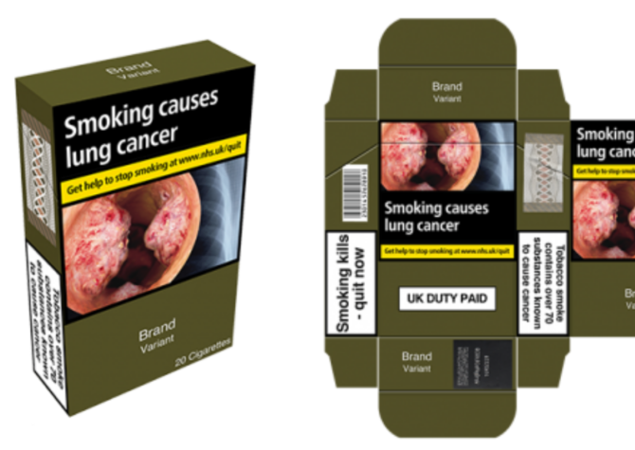
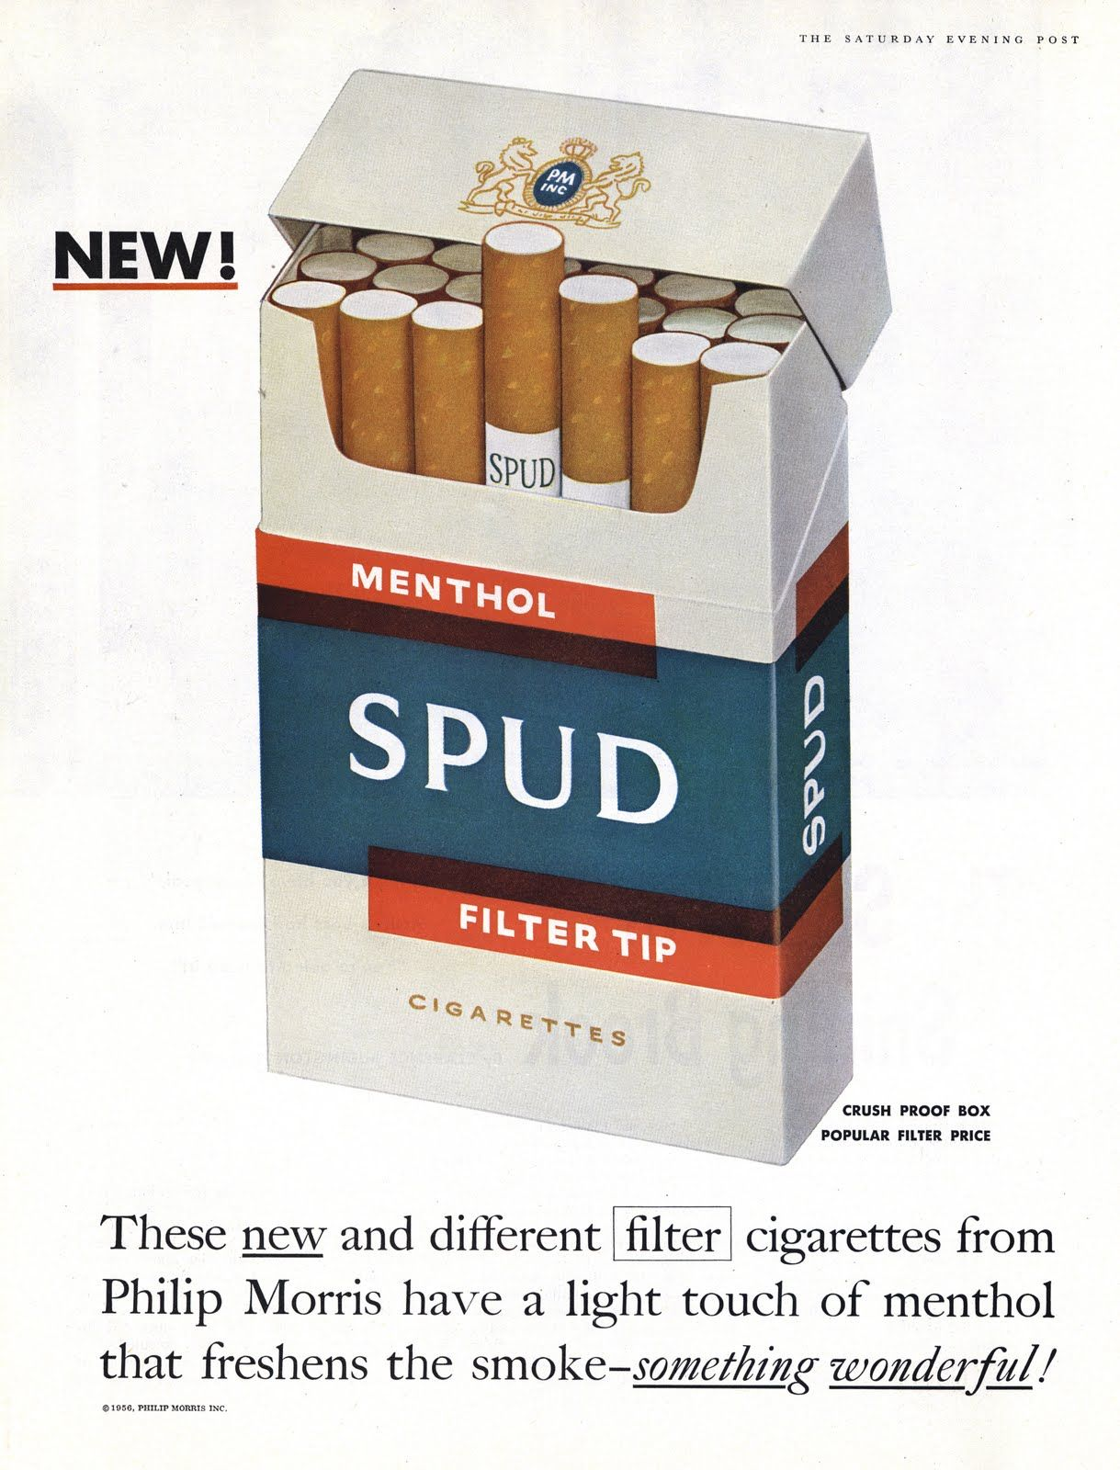
Plenary
Using the images, explain how the government’s approach to harm reduction has changed.
1950s
Now…
A survey found that this was the most unappealing colour (Pantone 448C) so the law made it a requirement that all tobacco products had to be this colour and carry health warnings such as Smoking Kills.
Notes:
5 minutes: Plenary Use images to show how the government’s approach to harm reduction has changed.

Slide 10
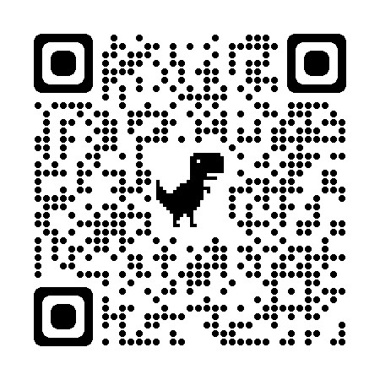
If you would like to learn more about nicotine or you are concerned about yourself or another person’s nicotine use:
Find out more
ash.org.uk
drugscience.org.uk
Click on the image above to find your nearest stop smoking services
Scan here for the NHS quit smoking page where you find advice and download the quit smoking app

